Slide 1
Fire That Qualifies
Abby Napora
Junction Covenant Church – July 24, 2016

Slide 2
Grace is a force God’s Caring and Rescuing Exertion
God holds onto us by His grace and we hold onto Him by our faith.

Slide 3
Three Types of Fire
Power Fire – Acts 1:8
Purifying Fire – Malachi 3: 2– Launderers soap and refiners fire
Directional Fire – Wilderness Navigation System – Exodus 12:21
Qualifying Fire - Daniel 3:27
Notes:
This walk of faith is not complicated. It is simple. God is not vague. He is clear about his instructions to us. So….here is what I want you to do.

Slide 4
Zechariah 9:11-12
Eternal One: As for you, because of the covenant promise I made with you through your ancestor David, a covenant sealed in blood, I will free your prisoners from the waterless pits of death. ¹² Return to your walled cities, safe and secure, O hostages of hope. I announce today that I will restore to you twice as much as what was taken.

Slide 5
Isaiah 43:1-3New King James Version (NKJV)
The Redeemer of Israel
43 But now, thus says the Lord, who created you, O Jacob, And He who formed you, O Israel: “Fear not, for I have redeemed you; I have called you by your name; You are Mine. ² When you pass through the waters, I will be with you; And through the rivers, they shall not overflow you. When you walk through the fire, you shall not be burned, Nor shall the flame scorch you. ³ For I am the Lord your God, The Holy One of Israel, your Savior; I gave Egypt for your ransom, Ethiopia and Seba in your place.

Slide 6
Daniel 3:20-30
Daniel 3:27 (NKJV) And the satraps, administrators, governors, and the king's counselors gathered together, and they saw these men on whose bodies the fire had no power; the hair of their head was not singed nor were their garments affected, and the smell of fire was not on them.

Slide 7
Qualifying Process
Even though we experience crisis in life we don’t have to live a life of crisis.
Living through crisis produces purpose.
Align yourself move toward God who is an unchanging standard. Your will and attitude must align with God and His word and will.
Avoiding crisis will rob you – of a quality of faith and which is rich and dynamic which leads to a powerful relationship of knowing Jesus and living your purpose.
Accepting crisis as a part of life allows you to tap into the God’s amazing grace, His tender mercies and His undying and perfecting love.
Notes:
http://books.google.ca/books?id=z1siAgAAQBAJ&pg=PA332&lpg=PA332&dq=Purpose+for+abundant+life&source=bl&ots=qHykcSEKmI&sig=ethDOU747CKrG0sXiH4b_HBI9AQ&hl=en&sa=X&ei=VoWBU9WzOJK8oQTZzIG4Dg&ved=0CEcQ6AEwAzgU#v=onepage&q=Purpose%20for%20abundant%20life&f=false

Slide 8
James 1:2-4
² Dear brothers, is your life full of difficulties and temptations? Then be happy, ³ for when the way is rough, your patience has a chance to grow. ⁴ So let it grow, and don’t try to squirm out of your problems. For when your patience is finally in full bloom, then you will be ready for anything, strong in character, full and complete. (Living)

Slide 9
James
²⁻⁴ Consider it a sheer gift, friends, when tests and challenges come at you from all sides. You know that under pressure, your faith-life is forced into the open and shows its true colors. So don’t try to get out of anything prematurely. Let it do its work so you become mature and well-developed, not deficient in any way. (message)

Slide 10
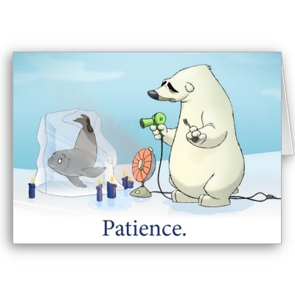
Patience
Patience is not a passive resignation to adverse circumstances, but a positive steadfastness that bravely endures.

Slide 11
Ephesians 3:20
²⁰ Now to Him who is able to do exceedingly abundantly above all that we ask or think, according to the power that works in us,

Slide 12
2 Peter 1:4
God took the first step to rescue us from this corrupt world. He has granted us His power, revealed to us true knowledge, and spoken to us great promises. He has done all this for a reason: that we might participate in His own nature and reflect His own life. But we are not passive observers of God’s saving actions. We must receive His grace, grow in knowledge, and join Him in this work of redemption. ( The Voice)

Slide 13
“The spiritual power demonstrated by Jesus, and the saints who have sought to imitate His cooperation with God, is the energy which continues to heal the world, to bring it into more and more wholeness. This specialized grace is available to any who wants to offer themselves in gratitude, to enlist in God's vision for humankind and to discover our proper place in creation as we serve. This is the grace that makes us into earth stewards for Christ's sake.”
Notes:
http://www.explorefaith.org/grace.html

